Slide 1
Group Advising for DNP
Betsy Mau
Graduate Program Advisor
Student and Academic Services

Slide 2
Helpful Links
https://grad.uw.edu/ (Graduate School)
https://grad.uw.edu/about-the-graduate-school/graduate-school-covid-19-information/ (Graduate School COVID-19 Information)
https://grad.uw.edu/policies-procedures/graduate-school-memoranda/memo-45-practice-doctorates/ (Graduate School Memorandum 45)
https://students.nursing.uw.edu/progression/forms-handbooks/ (SoN student forms)
https://nursing.uw.edu/students/progression/dnp/final-quarter/ (SoN DNP final quarter)
https://nursing.uw.edu/students/progression/certificates/final-quarter/ (Certificate)
https://iss.washington.edu/procedures/final-checklist/ (ISS final checklist for International Students)
https://www.washington.edu/students/reg/calendar.html (UW Academic Calendar)
Note:
You MUST be registered for classes the quarter you graduate and remain enrolled through the end of the quarter.
Digital signatures are permitted on all documents

Slide 3
DNP Requirements: Autumn Quarter
Digital signatures and electronic documents permitted
Formally establish your doctoral supervisory committee in NMETH 801 autumn quarter
Memorandum of Request to Establish Supervisory Committee for Doctor of Nursing Practice
Must be signed by your chair or co-chairs
At least one member must be faculty from your track
If you add a fourth member, state the reason and provide an e-mail address and place of employment, if they are not UW faculty
Please use the correct names and titles of your supervisory committee members
EXAMPLE: Chairperson: Jennifer Sonney PhD, ARNP, PPCNP-BC
Title and Dept: Assistant Professor, CFPHN
Check your e-mail for a confirmation from the Graduate School
MyGradProgram and your MyUW will show your supervisory committee

Slide 4
DNP Requirements: Autumn Quarter
Digital signatures and electronic documents permitted
Submit the following documents in your NMETH 801 class:
Use of Human and Animal Subjects acknowledgement
Program of Study Addendum if you received approval for course equivalency
Only those with a prior graduate degree in a related field can waive the credits
Official transcript required
Submit prior graduate degree transcript directly to the Graduate School
https://grad.uw.edu/admission/understanding-the-application-process/official-transcript-requirements/
Submit non-degree course transcript to Student and Academic Services (bmau@uw.edu)
DNP Project Proposal signed by your doctoral supervisory committee
Proposal must be both written and oral
Statement of Mutual Agreement signed by you, your agency, and your chair

Slide 5
DNP Requirements: Autumn Quarter
Digital signatures and electronic documents permitted
About your Program of Study
Curriculum grid for your cohort and track is automatically approved
Minimum 93 course credits – 24 of those credits must be NCLIN practicum
Variable credit courses must be accurate for your track
Minimum 1,000 clinical hours (all 801 credits count)
Course substitutions must be reviewed in advance and approved in writing by DNPCC
Submit a Program of Study Addendum for any course substitution
Approval for course equivalency must be from DNPCC and in writing
Only those with a prior graduate degree in a related field can waive the credits
Concurrent certificate or degree programs
Shared credits are limited. Consult your Graduate Program Advisor (Betsy Mau) regarding shared credits and your Program of Study

Slide 6
DNP Requirements: Final Quarter
Schedule your Final Exam in MyGradProgram when you know the date and location (Your DNP Project presentation is your final exam)
This action creates the warrant to grant your degree
Should be scheduled no later than 10 days before your final exam (defense) date
OPTIONAL: Run an audit of your degree in MyGradProgram when you schedule your final exam
MGP Student Log In: https://grad.uw.edu/for-students-and-post-docs/mygrad-program/
Complete the following documents, and submit them by project presentation day, as instructed in NMETH 801 :
Verification of Doctoral Degree Completed form
Digital copy of DNP Project Executive Summary
All requirements must be completed by 5:00pm the last day of the quarter
Not graduating winter quarter? Contact Betsy Mau bmau@uw.edu for special instructions

Slide 7
Other DNP Final Quarter Items
Complete the DNP End of Program Evaluation online https://catalyst.uw.edu/catalyst/chooser/22a95085cd2d7ac5ef8e87fa71ef6a4d
Optional: If the SMA that you signed with your agency grants permission, you may register your project with the Sigma Repository. You must have permission in writing from your project

Slide 8
Are you in a concurrent certificate or degree program? If so, the Graduate School asks you to:
Prepare an unofficial transcript that identifies which credits on your transcript are:
Solely DNP credits
Solely certificate credits or other-degree credits, and
Shared credits, if any (cannot be core to either program, if certificate)
Color-code the courses on the transcript with highlighter to distinguish the above-listed categories.
Adobe has a highlighter function, so this can all be done electronically.
Submit the marked-up transcript to the Graduate School here: https://uwnetid.sharepoint.com/sites/og_gs_gems/Lists/Concurrent/AllItems.aspx
Submit a copy for your electronic student file to Betsy Mau at bmau@uw.edu

Slide 9
Graduate Certificate (GCPAPN)
These are instructions for how to get your completed certificate awarded:
E-mail a Verification of Certificate Completed to Betsy Mau (bmau@uw.edu)
https://students.nursing.uw.edu/progression/final-quarter/
Your certificate program adviser should e-mail Betsy Mau (bmau@uw.edu) in Student and Academic Services confirming certificate completion

Slide 10
Other Important Items to Check
Review your unofficial transcript ahead of time for
93 credits minimum
18 numerically graded credits minimum
Accurate number of credits in variable-credit courses
Prior master’s degree posted to your transcript (if you were approved for course equivalency)
Missing (“X”) grades – contact the instructor to request a grade change
Unresolved Incompletes – If you completed the work, contact the instructor to request a grade change

Slide 11
Other Important Items to Check
The Graduate School will keep the following contingencies outstanding until after they do their final audit:
Must be enrolled …
The quarter of final exam
The quarter the degree is conferred
Through the end of the quarter

Slide 12
Other Important Items to Check
The name on your diploma will be your legal name as it appears in MyUW.
Did your legal name change? UW name change policy: https://registrar.washington.edu/students/name-change-policy/
If you want your name to appear a certain way on your diploma (e.g., full middle name, special markings, characters, spacing, etc.), submit a Diploma Name Request Form to the UW registrar by the last day of the quarter. Must include legal first and last name: http://depts.washington.edu/registra/forms/UoW1993.pdf

Slide 13
Turn in Your Stuff
Return any assigned keys to the person who assigned them to you
Empty your locker and notify HSB Management
Empty your student mail slot and remove your name from the hanging file in T-441

Slide 14
After Graduation
Keep us updated with your current contact information (asknursing@uw.edu and in MyUW)
If you have student loans, contact the UW OSFA to:
Know your lender and contact so that you stay current
Review post-graduation loan management and repayment information: https://www.washington.edu/financialaid/money-management/paying-for-school/pfs-loans/
Your UW NetID and MyUW account are yours indefinitely. As long as you remember your NetID and password, you may log in and make updates
The name on your degree will be as it appears in MyUW
Your degree will be mailed to the address you list in MyUW approximately 2 months after graduation

Slide 15
After Graduation
Your e-mail account will be closed 1 quarter + 10 days after graduation. To continue to access your UW email, you must forward emails sent to your UW account to a different address (a personal Gmail account, for example)
For e-mail forwarding, go to Manage UW NetID, here: https://uwnetid.washington.edu/manage/.

Slide 16
After Graduation
New graduates have access to the UW Libraries for 1 quarter after graduation. Check the UW Libraries website for questions about library access – they have live chat! http://www.lib.washington.edu/
UW Career & Internship Center has lots of resources for graduates and students, including one-on-one advising. Graduates can use their services for free up to 2 years after graduation!
Stay current through UW Continuing Nursing Education (UWCNE)
Advanced Practice in Primary and Acute Care National Conference every October
Pain Management Conference in January
Wound Management
Medical-Surgical Certification
Immediate Response Urgent Clinical Conference
Several online programs
http://www.uwcne.org/

Slide 17
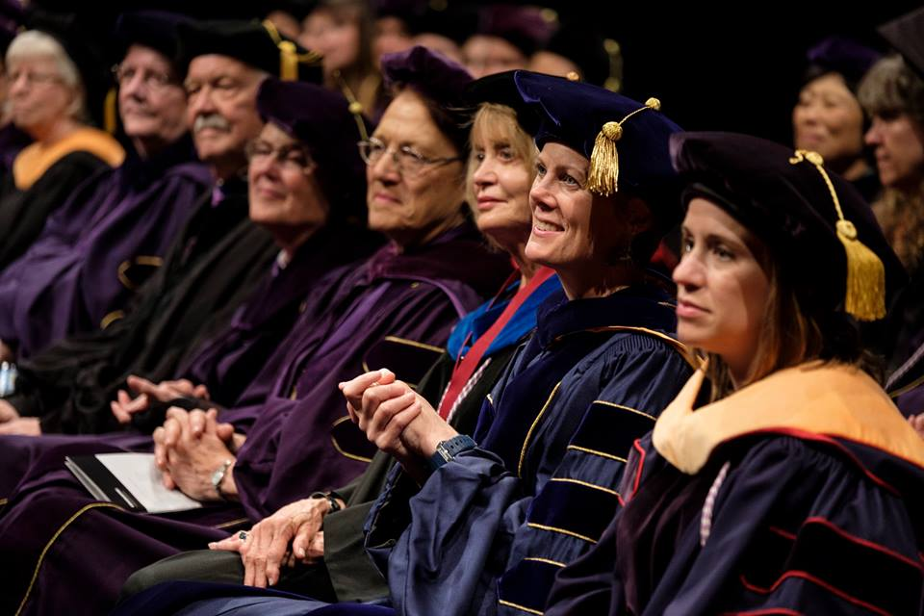
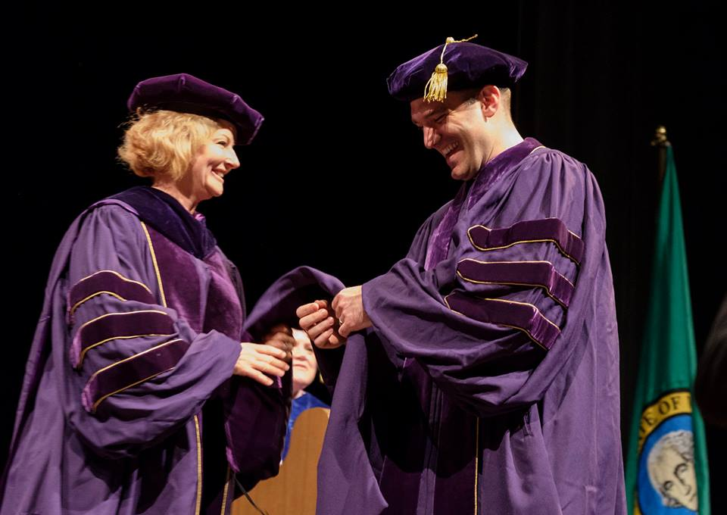
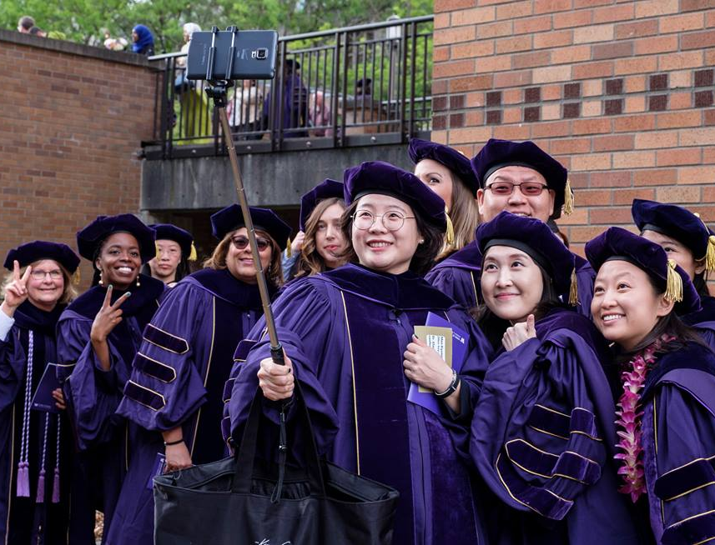
School of Nursing Convocation (Friday, last day of spring quarter, 9:30 a.m.) UW Commencement (Saturday following last day of spring quarter) Registration is required to participate Ceremonies subject to change based on distancing protocols See: https://www.washington.edu/graduation/

Slide 18
School of Nursing Convocation - Friday, last day of spring quarter UW Commencement – Saturday following last day of spring quarter
Ceremony Participation
Who is eligible to participate?
Those graduating the current academic year, plus the prior summer
Those planning to graduate the summer following spring quarter ceremonies (must get permission). For eligibility requirements, see: https://nursing.uw.edu/students/training/policies/convocation-eligibility/
Ceremony participation information can be found here (check occasionally for updates): http://www.washington.edu/graduation/.
Rent or purchase regalia
Purchase mementos (announcements, rings, photo frames, etc.): https://www.washington.edu/graduation/virtual-graduation-fair/

Slide 19
School of Nursing Convocation - Friday, last day of spring quarter
School of Nursing Convocation website: https://nursing.uw.edu/community/events/convocation/
Provide your contact information in our online survey, so we can update you about the ceremonies: https://catalyst.uw.edu/webq/survey/sonsas/312280
A live stream of the event will be available. Check the School of Nursing website for the link.

Slide 20
Questions?
Contact Betsy Mau
bmau@uw.edu
206-221-2418
Zoom https://washington.zoom.us/j/9097348649
http://www.meetme.so/BetsyMau to schedule a meeting
Online
Phone

