Slide 1
UW School of Nursing
Office of Clinical Placements, Compliance
Compliance Introduction and Q&A
  Meet Your Compliance Specialists
  Why Compliance Matters
  The Role of Nursing Students in Compliance
  DNP Compliance Requirements
  Student Expectations
  Compliance Timeline
  Tips & Tricks
  Q&A

Slide 2
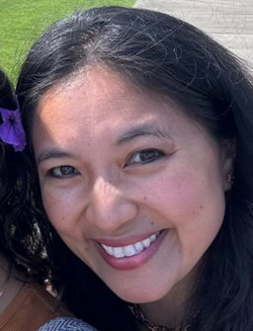
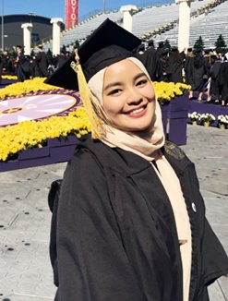
Meet your Compliance Specialists
We can help you with:
Contents of your welcome email
Exxat inquiries
Compliance renewal inquiries
Registration holds
General compliance questions
nscomply@uw.edu
Janelle Carroll
Lanna Lee

Slide 3
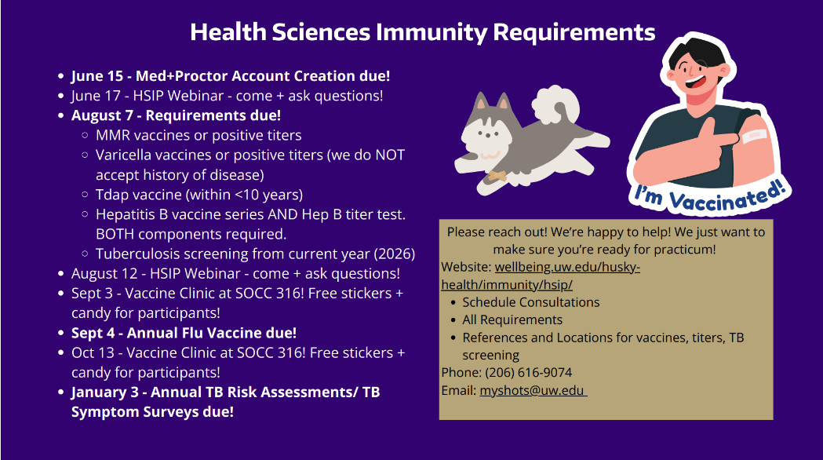

Slide 4
Why Compliance Matters
Compliance for nursing students: Involves following laws, regulations, guidelines, and ethical standards related to healthcare.
Key Components
  Regulatory Compliance: Adhering to healthcare laws and regulations.
  Institutional Compliance: Following the SON and clinical site policies and procedures.
  Ethical Standards: Maintaining integrity and ethical behavior in all professional activities.
Objectives
  Ensure patient safety and quality care.
  Protect yourself and your institution from legal risks.
  Foster trust and professionalism within healthcare settings.

Slide 5
The Role of Nursing Students in Compliance
1. Learning and Adhering to Policies
  Stay Informed: Regularly review and understand compliance policies and procedures.
  Ask Questions: Seek clarification from SON compliance at nscomply@uw.edu when in doubt.
2. Participating in Training and Completing Immunization Requirements
  Engage in Training: Actively participate in relevant trainings, certifications, and immunization requirements.
  Apply Knowledge: Implement what you learn in your clinical practice.
3. Practicing Ethical Behavior
  Patient Confidentiality: Always maintain patient privacy and confidentiality.
  Honesty and Integrity: Demonstrate ethical behavior in all interactions and documentation.
4. Reporting and Improving
  Incident Reporting: Promptly report any compliance issues or safety concerns.
  Continuous Improvement: Be open to feedback and strive for continuous improvement in your practice.

Slide 6
Student Expectations
All compliance requirements must be met by August 7, 2026 and must remain current at all times.
Students are responsible for monitoring your compliance items and ensuring they are renewed on time.
Students are responsible for all costs associated with compliance requirements (registration, trainings, immunizations, etc.)
Follow up with us when we’ve reached out to you.

Slide 7
By now, you should have:
Received your Exxat invitation email (different from the Exxat welcome email).
  Missing either email? Contact sonocp@uw.edu from your UW email with your name and program.
Received your Med+Proctor invitation to create your immunization account.
  Missing the email? Contact myshots@uw.edu from your UW email with your name and program.

Slide 8
Compliance Requirements/Deadlines
Pay enrollment deposit fee with UW and register for your UW NET ID
Register for Exxat and Med+Proctor by Monday, June 15, 2026
Submit religious/medical exemptions by June 15, 2026
Submit all compliance requirements by Aug 7, 2026
Submit 2026-2027 school year flu shot by Sept 4, 2026

Slide 9
Updates
The Background Check action item on Exxat is still in progress and has not yet been established. Please do not submit anything in Exxat until you receive instructions from SON Compliance.
All updates will be posted on the SON Compliance website: https://students.nursing.uw.edu/clinicals-compliance/compliance-onboarding/

Slide 10
Resources
Visit our website for important dates, deadlines, documents, tutorials, and more!
  https://students.nursing.uw.edu/clinical-skills/compliance/
General questions and assistance with Exxat?
  Email SON compliance at nscomply@uw.edu
Questions about immunization requirements and/or need assistance with Med+Proctor?
  Email UW HSIP at myshots@uw.edu
  HSIP Website: https://wellbeing.uw.edu/husky-health/immunity/hsip/
UW Husky Health to schedule your immunization appointments: https://wellbeing.uw.edu/husky-health/
DNP Advisor - dnpadvising@uw.edu.

Slide 11
Tips to Stay Ahead
Check your emails daily for potential updates.
Visit the SON compliance and HSIP websites for references on when and how to complete your compliance renewals.
Familiarize yourself with the quarterly compliance renewal dates and start your renewals at least 3 weeks before the renewal date. You may even submit a renewal early.
Email us as early as possible if you have any questions or concerns.

Slide 12

Open for Q&A
Thank you
GO DAWGS!

